Slide 1
ML Model Building on “Income Evaluation”
By Srinivas D

Slide 2
Steps Followed & Observations
At first understanding the problem statement,
“This is the data of ‘Income evaluation for different countries.’ Based on the available features, build a model to predict whether a person's income exceeds a certain threshold (e.g., <=50K or >50K), which will help to identify the factors that contribute to higher incomes.”
Performing basic data cleaning steps:
  Removed the column with NaN values and stripped the column names of extra space, removing the duplicate rows, etc...
  Separating both numerical and categorical columns for easy analysis, replacing missing values.
  Then performed univariant, bivariant, and multivariant analyses for understanding the hidden patterns
Observations:
1. The target column is imbalanced
2. The 'capital_gain', 'capital_loss', and 'final_census' columns will having the more skewness as mean is very far from the median.

Slide 3
Steps Followed & Observations
Observations:
3. 'Final_census' has outliers in the upper fence, and there is a huge jump between 99% and 100% of the data, which can be trimmed.
4. In 'Education' Col almost 80% of people belong to 'HS-grad' and 'some-college,' and least are pre-school
5.In 'Marital-status' col has more marreied-civ-spouse and then followed by never married
After this performed the model building steps by separating the target and independent variables
1. Used SMOTE,SMOTEENN techniques to balance the target column

Slide 4
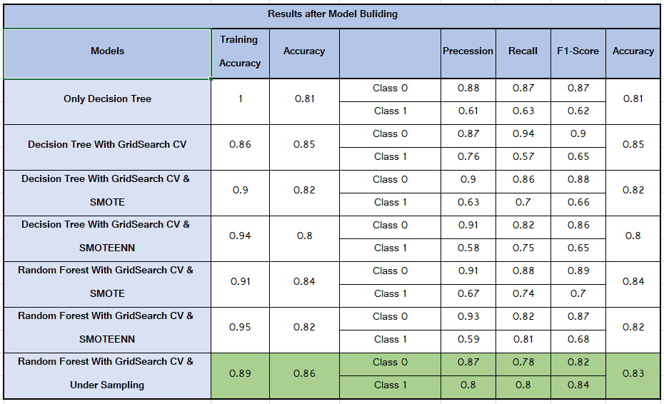
Results
The results after building models:
Among all the models the last model with the undersampling technique given the better result but here we are wasting so much of the data.
After that the Random Forest with GridSearch CV & SMOTE gave the better result

